Slide 1
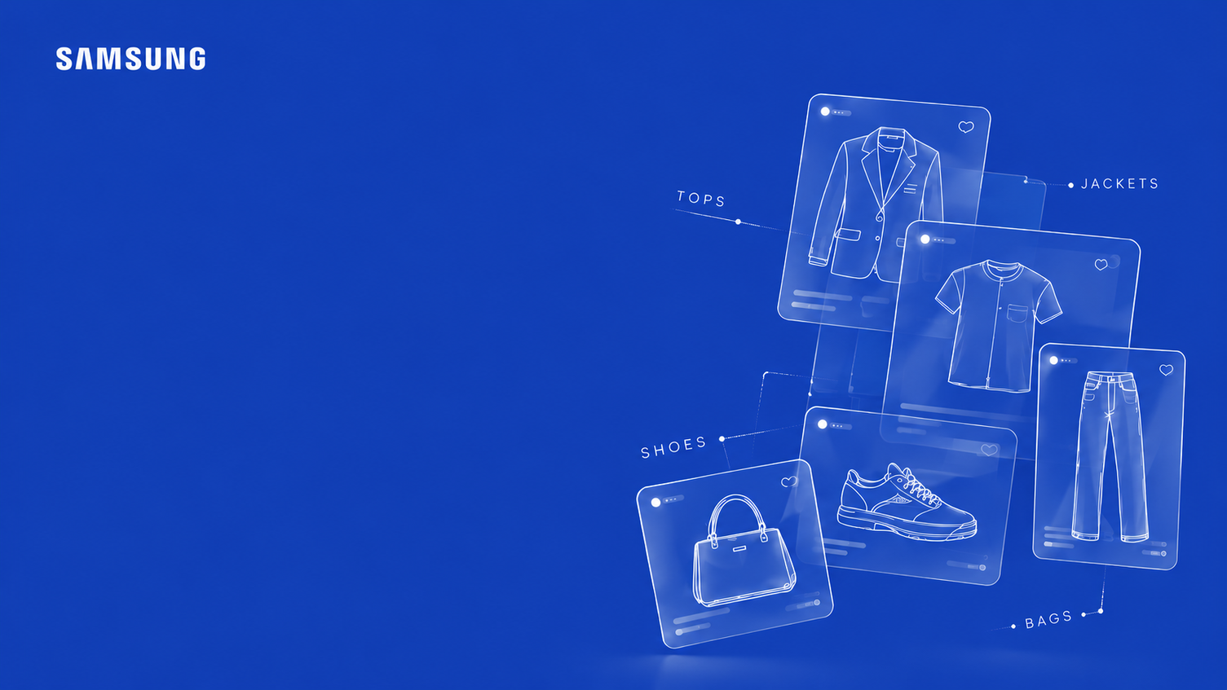


Beyond The Purchase
SIC – AI800
Notes:
Note:
1

Slide 2

Agenda
  Team Members
  Problem & Solution
  Dataset and Preparation
  EDA (Exploratory Data Analysis)
  Architecture and Models
  Results and Evaluation
  Demo
  Business Value and Conclusion
Samsung Innovation Campus

Slide 3



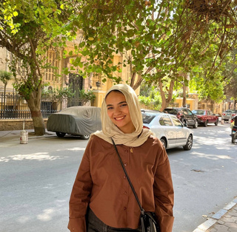
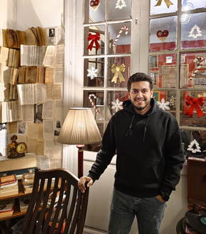
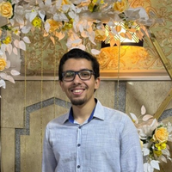
Meet Our Team!
Mariam
Reda
Nada
Mahmoud
Nourhan
Atef
Yousef
Bahgt
Ammar
Yasser
Samsung Innovation Campus

Slide 4

Problem and Solution
Samsung Innovation Campus
Notes:
Note:
2

Slide 5
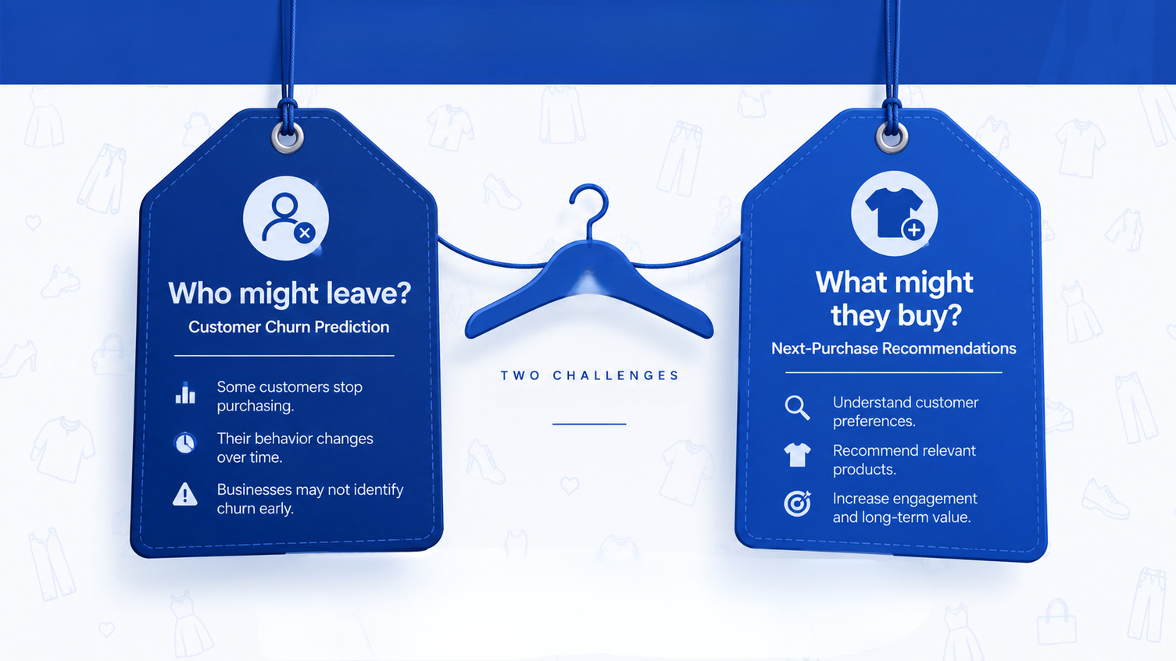
Problem and Solution
Samsung Innovation Campus

Slide 6
Dataset and Preparation
Samsung Innovation Campus
Notes:
Note:
2

Slide 7
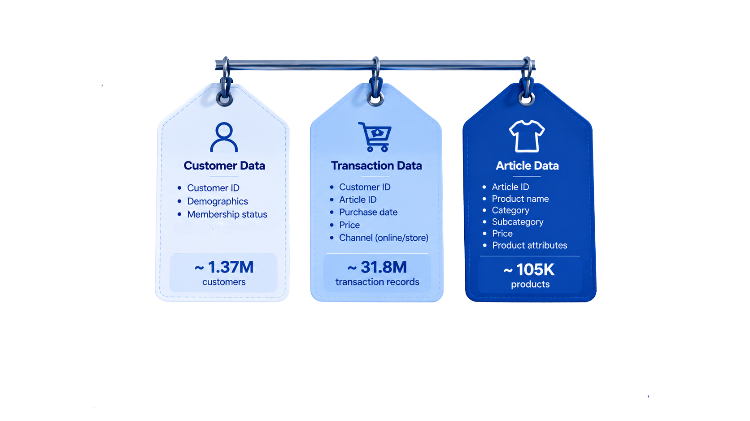
Dataset and Preparation
Samsung Innovation Campus

Slide 8
Dataset and Preparation
  Data Cleaning: Handled missing customer values, filled missing product descriptions, and checked duplicates, data types, and invalid prices.
  Data Integration: Connected customer, transaction, and article datasets using customer IDs and article IDs.
  Temporal Splitting: Used time-based training and validation periods to prevent future purchase information from leaking into historical features.
  Model-Ready Data: Encoded categorical variables, scaled numerical features where needed, and prepared separate datasets for churn prediction and product ranking.
Samsung Innovation Campus

Slide 9
EDA (Exploratory Data Analysis)
Samsung Innovation Campus
Notes:
Note:
2

Slide 10
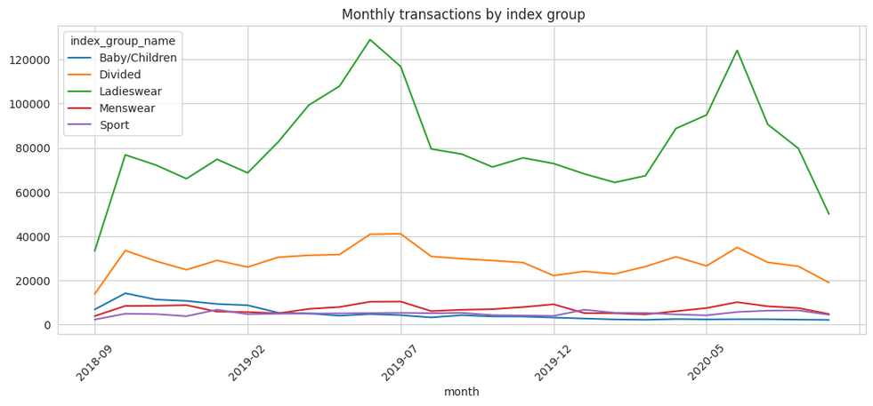
EDA (Exploratory Data Analysis)
When do we sell most, and is there seasonality?
Key Finding: Ladieswear drives most sales and peaks every June (~129K in 2019, ~124K in 2020)
Divided is a distant second, while Menswear, Sport and Baby/Children stay small
Samsung Innovation Campus

Slide 11
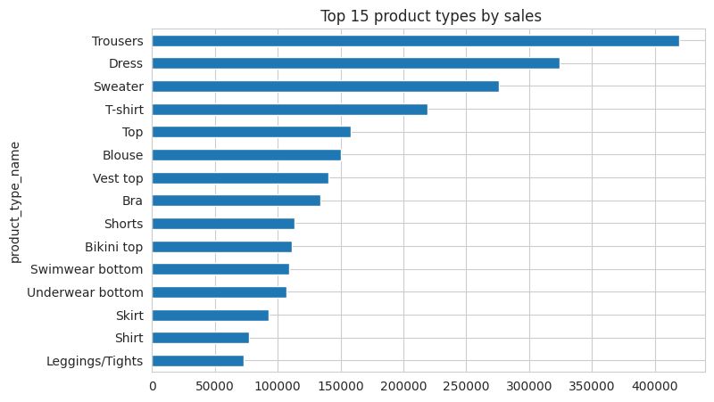
EDA (Exploratory Data Analysis)
Which product types drive sales?
Key finding: Trousers (~420K), dresses (~325K) and sweaters (~275K)
are the topselling product types.
Samsung Innovation Campus

Slide 12
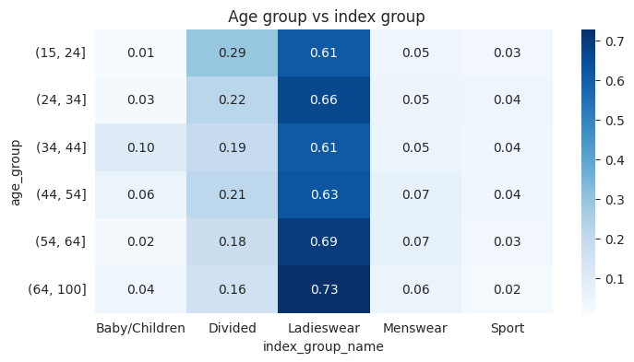
EDA (Exploratory Data Analysis)
Who are our customers, and what does each age group buy?
Key finding: The median customer is 32 years old, and the heatmap shows which segment each age group buys from.
Samsung Innovation Campus

Slide 13
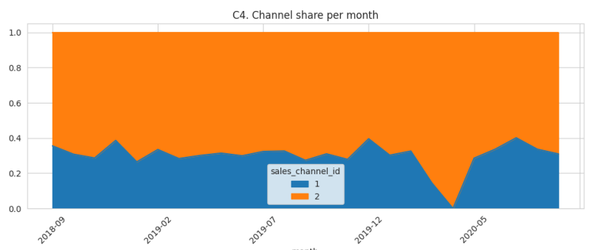
EDA (Exploratory Data Analysis)
Do customers buy online or in store?
Key finding: About 70% of transactions come from channel 2 (online) and 30% from channel 1 (stores). Store share collapses in spring 2020
Samsung Innovation Campus

Slide 14
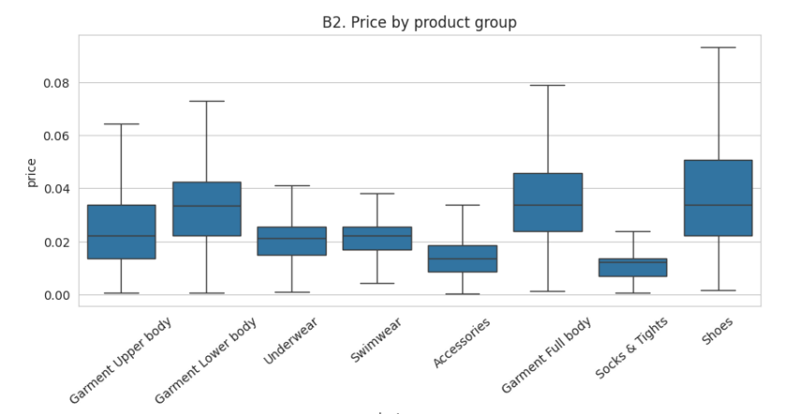
EDA (Exploratory Data Analysis)
Which categories are premium vs budget?
Key finding: Shoes, full body and lower body garments have the highest median prices
(~0.034, normalized), while accessories and socks & tights are the cheapest (~0.012–0.013).
Shoes show the widest spread
Samsung Innovation Campus

Slide 15
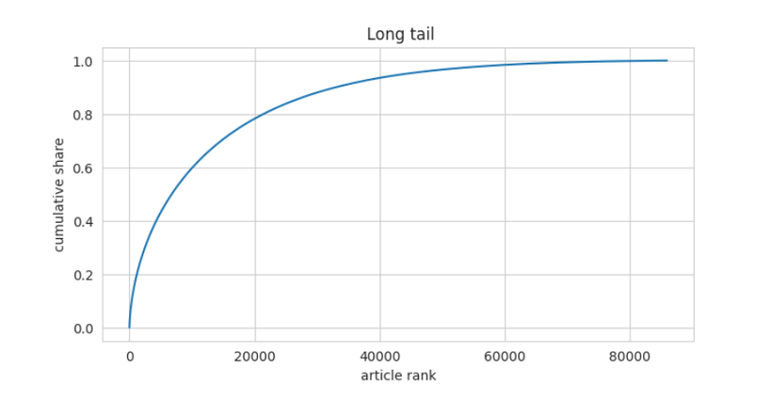
EDA (Exploratory Data Analysis)
How concentrated are sales across products?
Key finding: The top 100 articles make up 4.6% of sales, the top 1,000 make 18.2% and the top 10,000 make 59.8%. Demand is spread over a long tail, so popularity alone can’t personalize
Samsung Innovation Campus

Slide 16
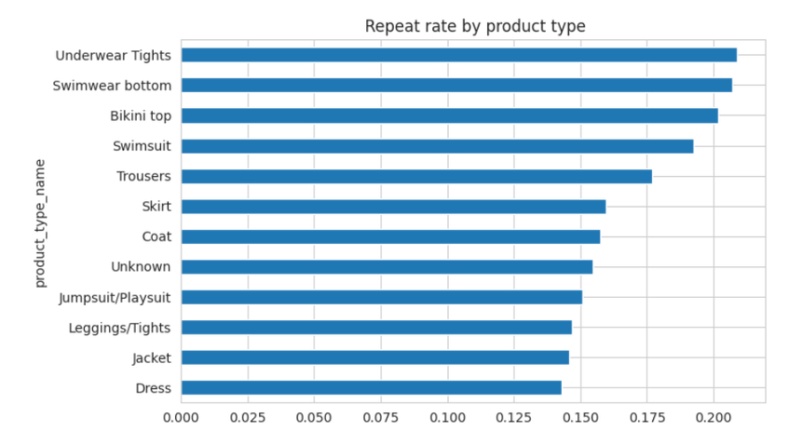
EDA (Exploratory Data Analysis)
Do customers rebuy the same item?
Key finding: Only 12.9% of customer article pairs are bought more than once
but swimwear and underwear/tights reach ~20%, so re-buy recommendations fit these types best
Samsung Innovation Campus

Slide 17
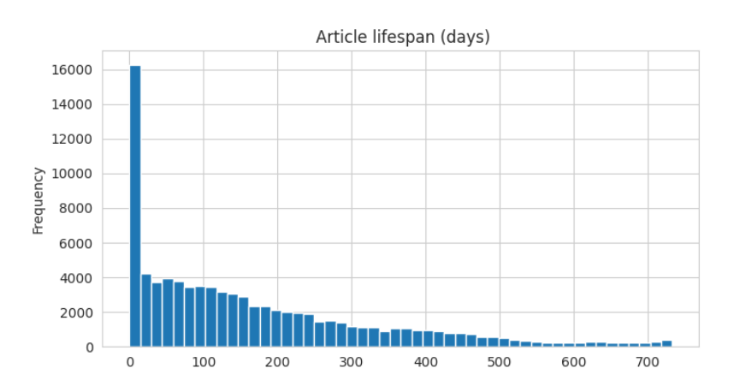
EDA (Exploratory Data Analysis)
How fast do products go out of fashion?
Key finding: The median article sells for 120 days, and 23.8% sell for under 30 days. Recent popularity matters more than all-time popularity
Samsung Innovation Campus

Slide 18
Modeling & Evaluation
Samsung Innovation Campus
Notes:
Note:
2

Slide 19

Architecture
Samsung Innovation Campus

Slide 20
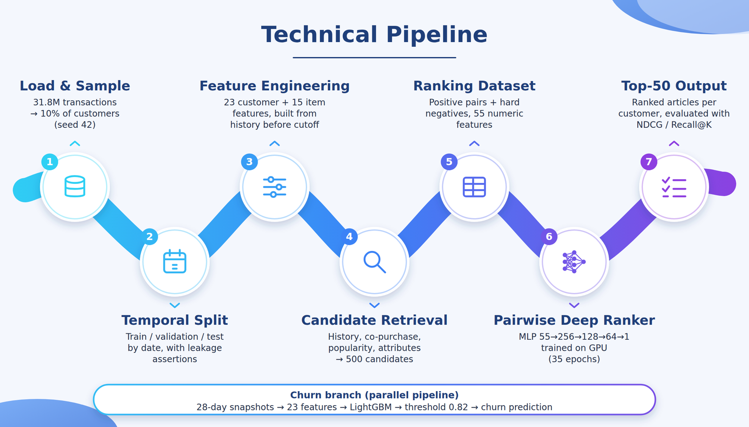
Technical Pipeline
Samsung Innovation Campus

Slide 21
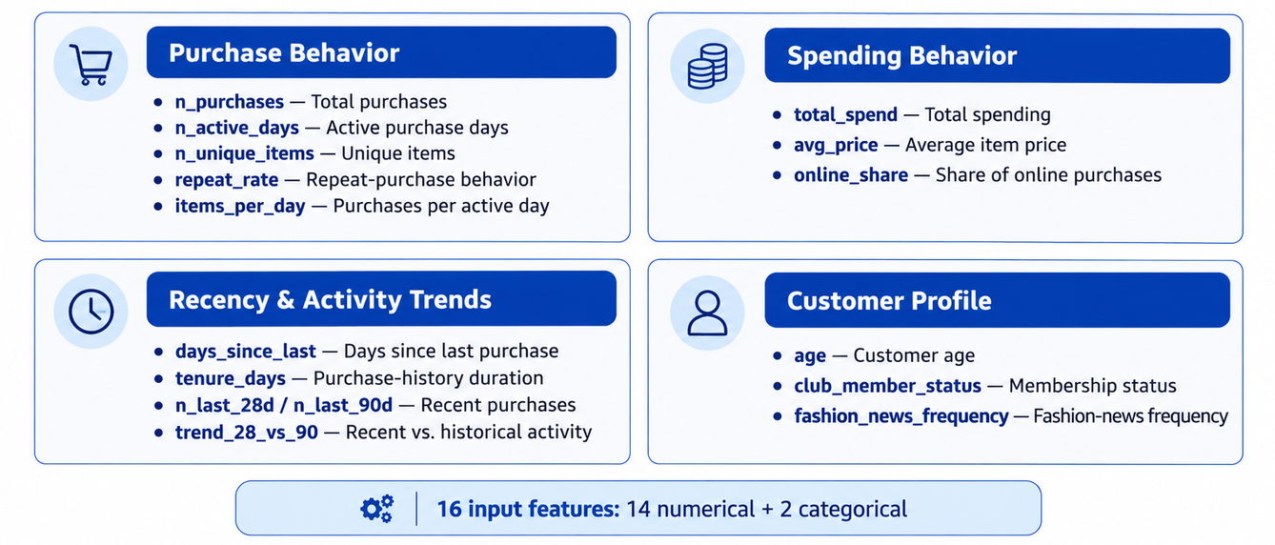
Feature Engineering
Feature Engineering for Churn model
Samsung Innovation Campus

Slide 22
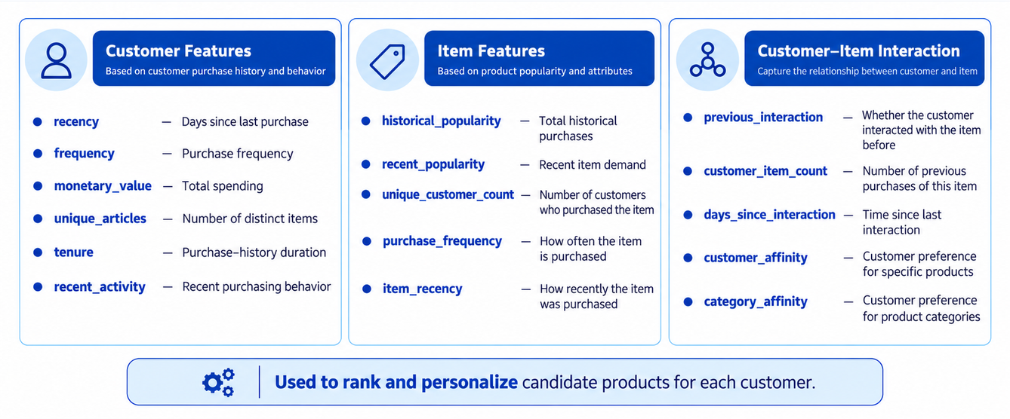
Feature Engineering
Feature Engineering for Recommendation & Ranking
Samsung Innovation Campus

Slide 23
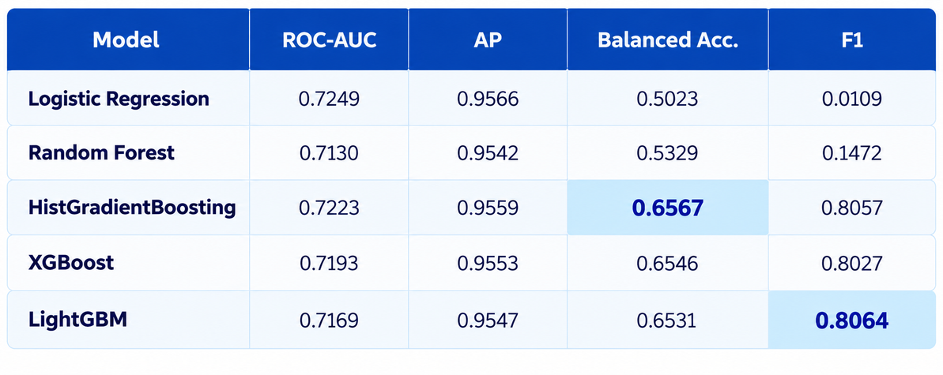
Churn Modeling Experiments
Experiment 1 — Baseline Models
  The baseline experiment compared five classification models; HistGradientBoosting achieved the highest Balanced Accuracy (0.6567), while LightGBM achieved the highest F1-score (0.8064).
Samsung Innovation Campus

Slide 24
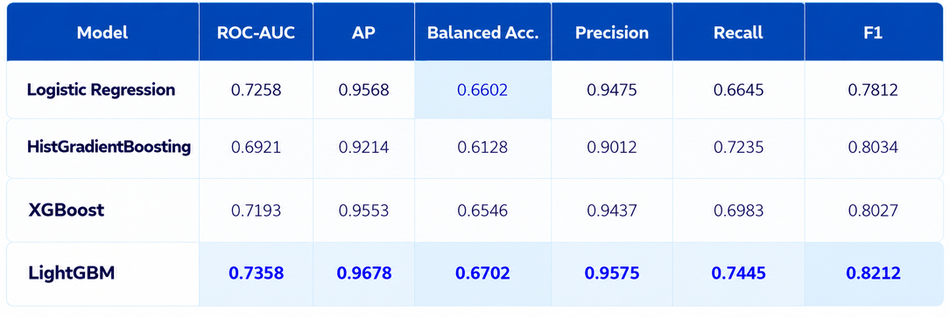
Churn Modeling Experiments
Experiment 2 – Improved Models
  We improved the baseline models through hyperparameter tuning, threshold optimization, and adjustments to class weights and training settings to improve churn classification performance.
  What Changed from Experiment 1 ?
  Applied hyperparameter tuning to the models.
  Adjusted the decision threshold to improve minority-class detection.
  Modified class weights and training settings.
Samsung Innovation Campus

Slide 25
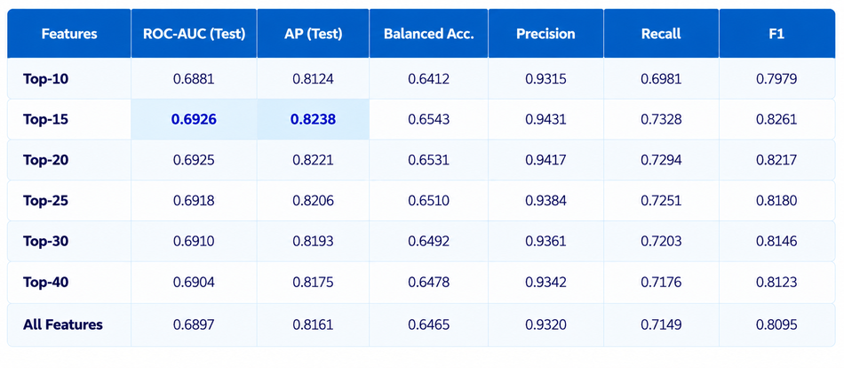
Churn Modeling Experiments
Experiment 3 – Feature Selection
  We evaluated different feature subsets using LightGBM to determine whether reducing the number of input features could improve churn prediction performance.
  What Changed from the Previous Experiment?
  Selected features based on feature importance.
  Compared Top-10, Top-15, Top-20, Top-25, Top-30, and Top-40 feature subsets.
  Evaluated each subset using ROC-AUC and Average Precision (AP).
Samsung Innovation Campus

Slide 26
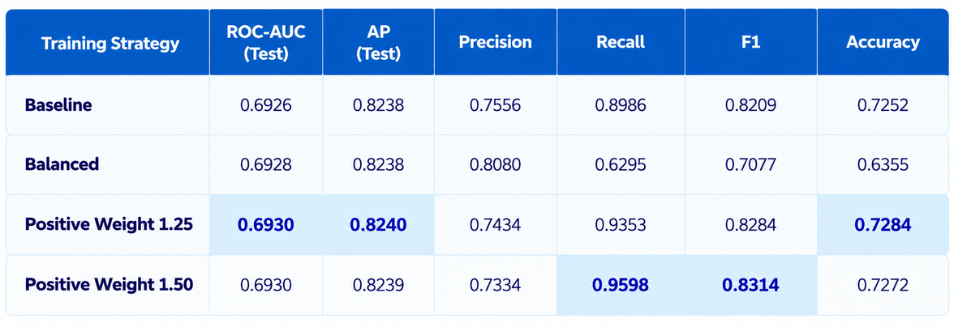
Churn Modeling Experiments
Experiment 4 – Training Strategy & Class Imbalance
  We tested different training strategies using LightGBM and the selected Top-15 features to study the effect of class weighting on churn prediction.
  What Changed from Experiment 3?
  Kept the selected 15 input features fixed.
  Changed the training strategy and positive-class weighting.
  Compared Baseline, Balanced, Positive Weight 1.25, and Positive Weight 1.50.
Samsung Innovation Campus

Slide 27
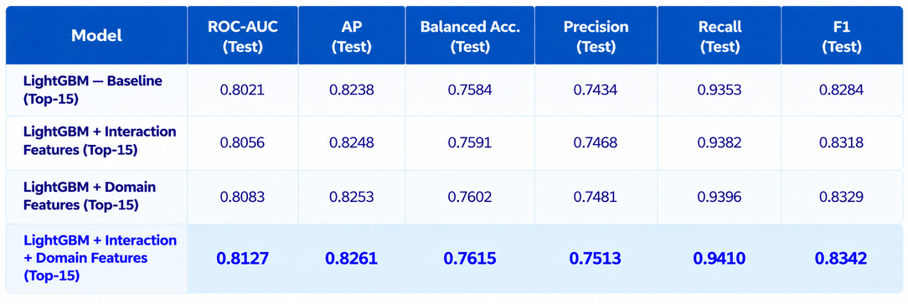
Churn Modeling Experiments
Experiment 5 – Expanded Top-15 LightGBM
  We enhanced the Top-15 LightGBM model by adding interaction features and domain-specific features to improve churn prediction.
  What Changed from Experiment 4?
  Kept the Top-15 selected features as the baseline.
  Added customer interaction features.
  Added domain-specific features.
  Evaluated the combined effect of both feature groups
Samsung Innovation Campus

Slide 28
Retrieval Overview
  We tested 10 retrieval experiments to generate the best candidate list per customer for the ranking model.
  Evaluation: 222 validation customers, with Recall, Precision, HitRate, NDCG and MAP.
  The 10 experiments cover four families:Single-source: popularity, customer history, item co-occurrence, feature similarity.
  Hybrid merging of the sources.
  Personalized multi-signal scoring (attributes + recency).
  A final tuned configuration returning Top-500 candidates.
  We present the 3 most important: History, Hybrid, and the Final Multi-Signal retrieval.

Slide 29
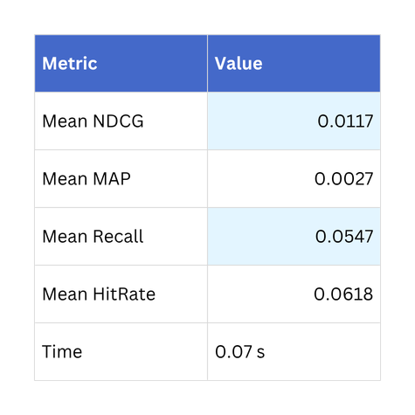
Experiment 2 Customer History Retrieval
  Recommends items based on each customer’s own recent purchases (last 20 items).
  It was the strongest single-source method, and it is also the fastest.
Takeaway:
a customer’s own history is the most reliable signal, ahead of co-occurrence (NDCG 0.0087) and feature similarity (0.0013).

Slide 30
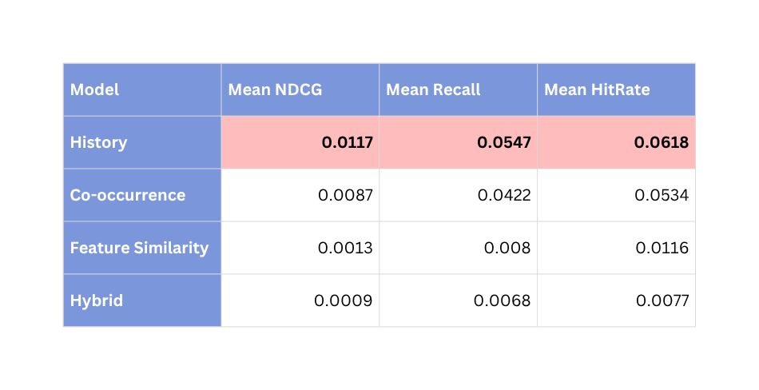
Experiment 5 Hybrid Multi-Source Retrieval
We combined the four sources (history-heavy weighting) hoping to beat each one alone.
Takeaway: simply merging sources hurt performance (0.0009 vs 0.0117), so the signals need to be combined inside one personalized score, not just concatenated.

Slide 31
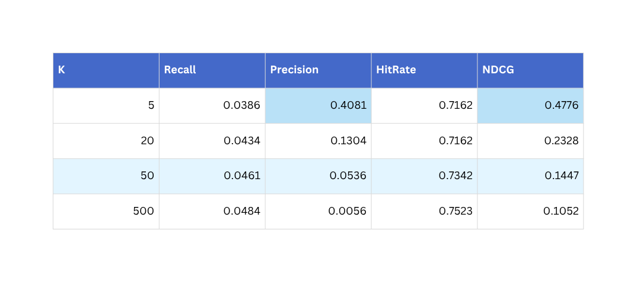
Experiment 9 Final Multi-Signal Retrieval
  One personalized score per customer from 5 signals, returning the Top-500 candidates.
  Weights: History 0.30, Attribute 0.30, Co-purchase 0.15, Recency 0.15 (30-day half-life), Popularity 0.10.
  Retrieval time: 16.9 s for 222 customers.
  Takeaway: recall saturates around K = 50, so a short candidate list captures almost everything. Overall recall is still low, so retrieval limits the final recommender (next step: collaborative filtering / ALS).

Slide 32
Results and Evaluation
Samsung Innovation Campus
Notes:
Note:
2

Slide 33
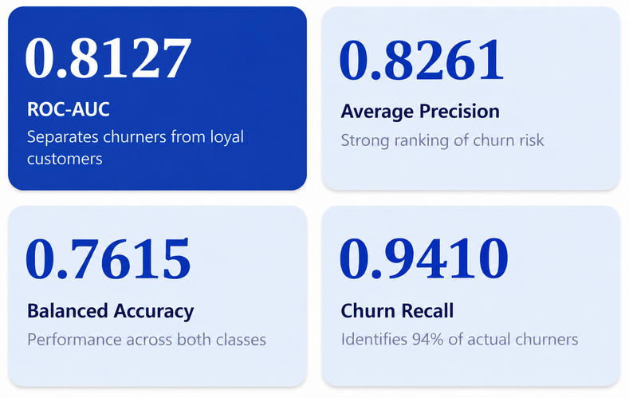
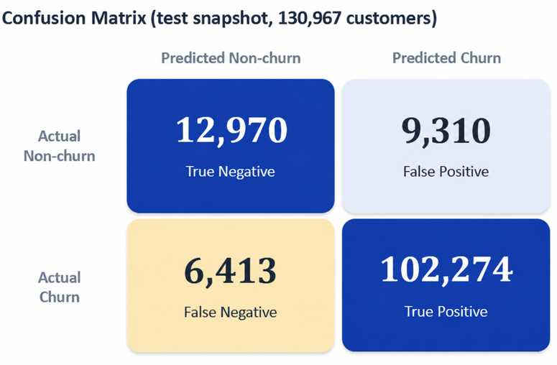
Results and Evaluation
Churn Prediction | Final Test Performance
  Final Model: LightGBM with 23 behavioral features and a 28-day observation window, selected for churn prediction, achieving ROC-AUC = 0.8127, Average Precision = 0.8261, and Balanced Accuracy = 0.7615 on the modified results shown
Samsung Innovation Campus

Slide 34
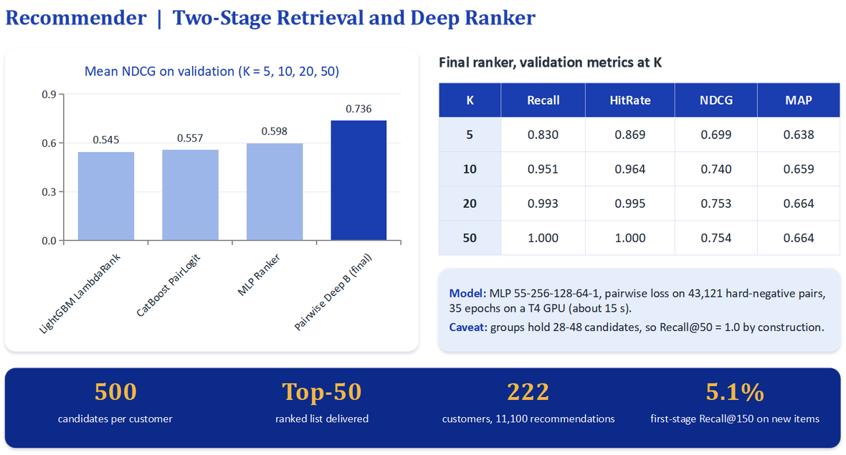
Results and Evaluation
Samsung Innovation Campus

Slide 35
Quick Demo
Samsung Innovation Campus
Notes:
Note:
2

Slide 36
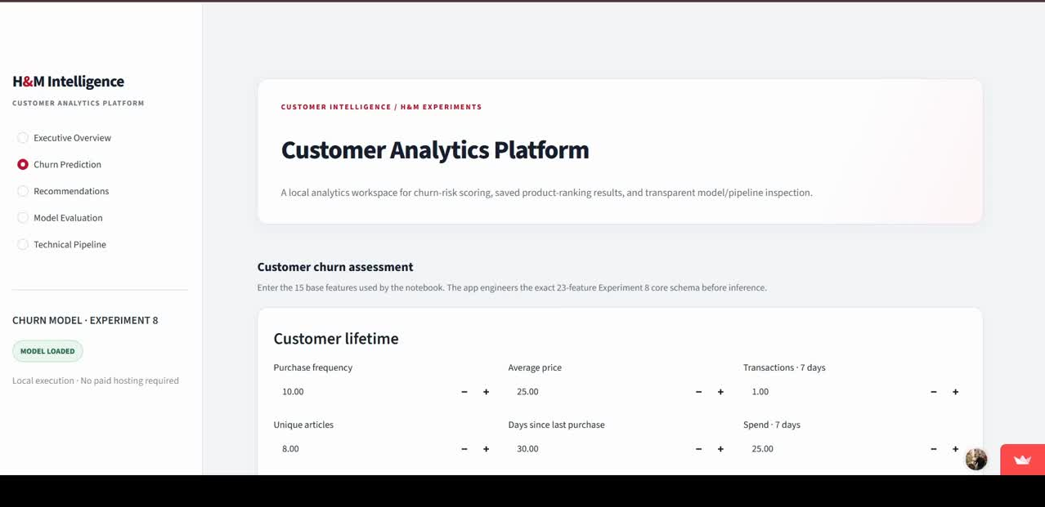
Quick Demo
Samsung Innovation Campus

Slide 37
Business Value and Conclusion
Samsung Innovation Campus
Notes:
Note:
2

Slide 38
Business Value and Conclusion
  Customer Retention: Identify customers at risk of churn and support targeted retention campaigns.
  Personalized Recommendations: Suggest relevant products based on customer preferences and purchase history.
  Smarter Marketing: Target the right customers with more relevant offers and promotions.
  Improved Customer Experience: Make product discovery easier through personalized shopping suggestions.
  Customer Loyalty: Encourage repeat purchases and strengthen long-term customer relationships.
Samsung Innovation Campus

Slide 39

Business Value and Conclusion
  Data-Driven Decisions: Use machine learning insights to support marketing and business strategies.
  Potential Revenue Growth: Improve opportunities for repeat purchases and reduce customer loss.
Samsung Innovation Campus

Slide 40

ⓒ2020 SAMSUNG. All rights reserved.
Samsung Electronics Corporate Citizenship Office holds the copyright of book.
This book is a literary property protected by copyright law so reprint and reproduction without permission are prohibited.
To use this book other than the curriculum of Samsung innovation Campus or to use the entire or part of this book, you must receive written consent from copyright holder.
Notes:
14

